Slide 1
普遍法则与架构
Universal laws
and architectures:
Theory and lessons from brains, hearts, cells, grids, nets, bugs,
fluids, bodies, planes, docs, fire, fashion,
earthquakes, music, buildings, cities, art, running,
cycling, throwing, Synesthesia, spacecraft, statistical mechanics
大脑
and zombies
John Doyle 道耀
Jean-Lou Chameau Professor
Control and Dynamical Systems, EE, & BioE
John Doyle 道耀
Chameau Professor of Advanced Neoteny
Control and Dynamical Systems, EE, & BioE
John Doyle 道耀
Jean-Lou Chameau Professor
Control and Dynamical Systems, EE, & BioE
#
Ca
1
tech
https://www.cds.caltech.edu/~doyle

Slide 2
普遍法则与架构
Universal laws
and architectures:
The videos
The following preview is approved for all audiences.
and zombies
https://www.cds.caltech.edu/~doyle

Slide 3
Questions
Thanks to Anish Sarma

Slide 4
Lifespan, violence, cancer, wound healing, and sociality
Universal laws
and architectures:
With
Lea Goentoro
Lior Pachter
Matt Thomson
Videos

Slide 5
Szekely P, Korem Y, Moran U, Mayo A, Alon U (2015)
The Mass-Longevity Triangle: Pareto Optimality and the Geometry of Life-History Trait Space.
PLOS Computational Biology 11(10):
e1004524. https://doi.org/10.1371/journal.pcbi.1004524
http://journals.plos.org/ploscompbiol/article?id=10.1371/journal.pcbi.1004524

Slide 6
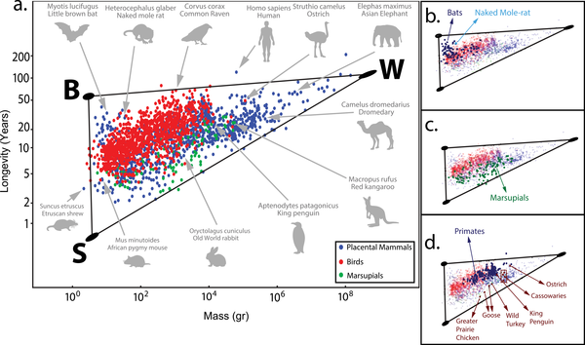
The Mass-Longevity Triangle
Longevity (years)
Mass
(gr)

Slide 7
Longevity (years)
Mass
(gr)

Slide 8
Longevity (years)
Long life can evolve iff violence is avoided
Fly
Burrow
Social
Big
Mass
(gr)

Slide 9
Longevity (years)
Long life can evolve iff violence is avoided
Fly
Burrow
Social
Big
What can go wrong?
Mass
(gr)

Slide 10
Long life but cancer?
Longevity (years)
What can go wrong?
Mass
(gr)

Slide 11
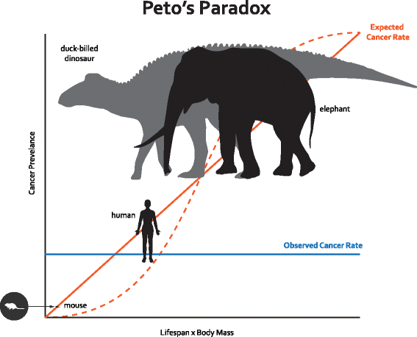
Peto’s Paradox: Cancer is a disease of uncontrolled cell growth and division, and the risk of developing cancer increases with the number of cell divisions during the lifetime of an organism. Thus, the expected cancer rate for large and/or long-lived species is higher than for smaller short-lived ones.
The solid red line indicates a linear relationship between cancer rate and (body mass)*(lifespan) and the dashed red line represents an approximation of the expected cancer rate assuming a model describing the probability of an individual developing colorectal cancer after a given number of cell divisions [4]. The solid blue line represents the observation that there is no relationship between cancer risk and (body mass)*(lifespan) [5].
Expected
Cancer prevalence
Observed
Lifespan x Body Mass

Slide 12
Long life but cancer?
Less cancer than expected
Longevity (years)
Mass
(gr)

Slide 13
Long life but cancer?
Less cancer but
Poor wound healing
Longevity (years)
Mass
(gr)

Slide 14
Long life but cancer?
Less cancer but
Poor wound healing
Longevity (years)
Less violence
Fly
Burrow
Social
Big
Mass
(gr)

Slide 15
Long life but cancer?
Less violence
Fly
Burrow
Social
Big
Less cancer but
Poor wound healing
A related triangle.

Slide 16
hydra
NMR?
Termite queen?
Giant squid
(counter)examples?

Slide 17
Long life but cancer?
Less violence
Fly
Burrow
Social
Big
Less cancer but
Poor wound healing
Social
Big

Slide 18
Elephants
Orcas
Social
Big

Slide 19
Elephants
Orcas
Long life but cancer?
Less violence
Fly
Burrow
Social
Big
Less cancer but
Poor wound healing
Social
Big

Slide 20
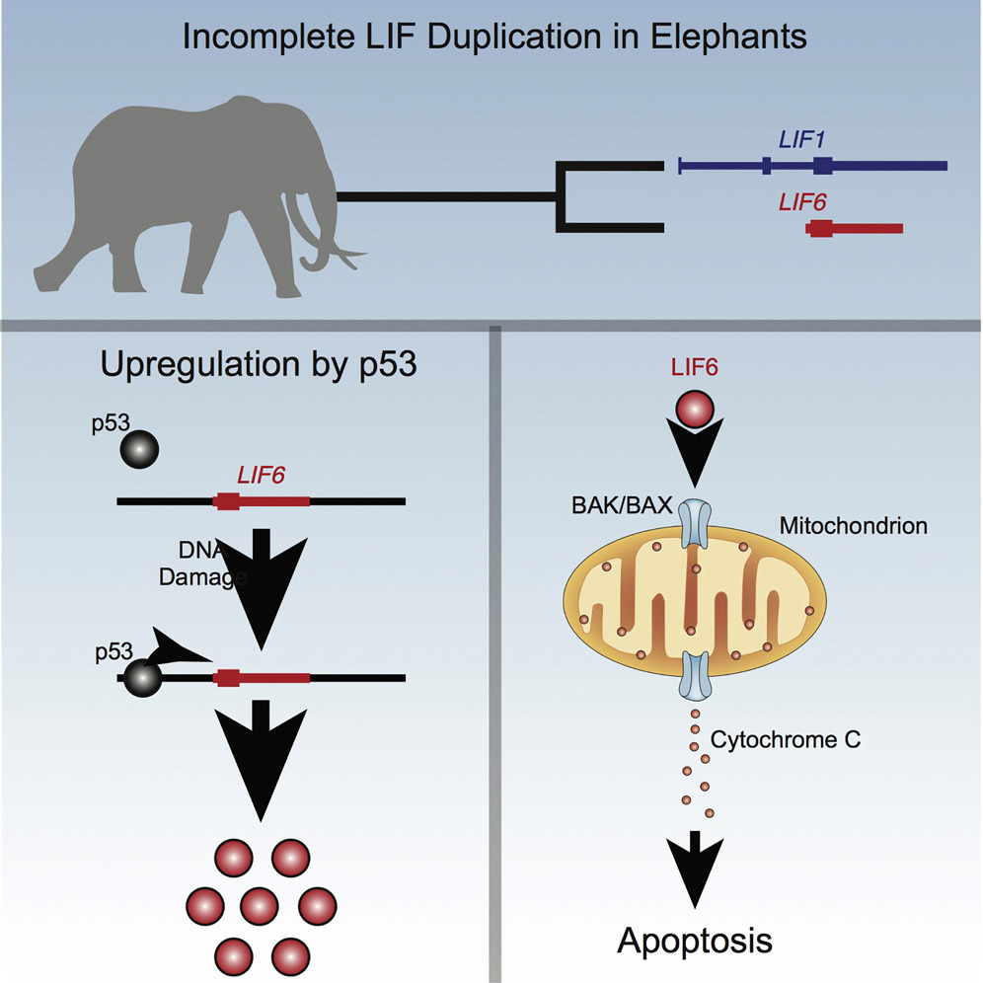
A p53 pathway upregulates cell death in elephants
Vazquez, …, Lynch, Cell Reports, 2018

Slide 21
Elephants
Orcas
Social
Big

Slide 22
(Cartoon of) Dynamics of wound healing
Bentzinger et al, 2013

Slide 23
(Cartoon of) Dynamics of wound healing
Mechanisms turn on and off
— Granulocytes
— Monocytes
— Macrophages
— Fibro-adipo progenitors
— Fibroblasts
— Vascular cells
— Satellite cells & myoblasts
— Differentiating myocytes
— Myofibers
Bentzinger et al, 2013

Slide 24
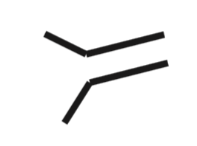
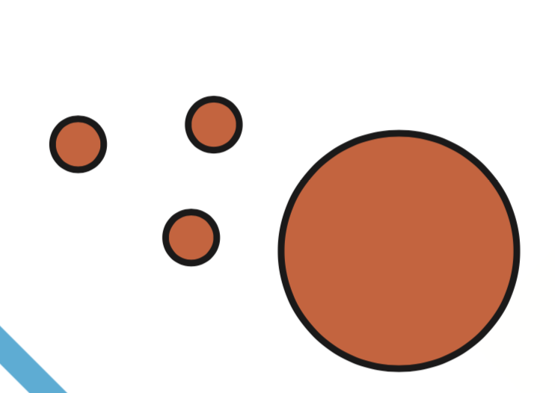
(Cartoon of) layered architecture of immune system
Adaptive
Killer T cells
TH cells
B cells
Innate
Neutrophils
Phagocytes
Intracellular
Apoptosis
ROS Secretion
(Auto)phagy

Slide 25
Molecular Level
Intracellular
Apoptosis
ROS Secretion
(Auto)phagy

Slide 26
Molecular Level
Apoptosis
ROS Secretion
Safe
(Auto)phagy
Effective

Slide 27
Basic tradeoff in immune defense:
effective defense also hurts host
Molecular Level
Apoptosis
ROS Secretion
(Auto)phagy
Safe
Effective

Slide 28
Broadly conserved
Intracellular
Apoptosis
ROS Secretion
(Auto)phagy

Slide 29
Multicellular Level
System Layers
Innate
Neutrophils
Phagocytes
Intracellular
Apoptosis
ROS Secretion
(Auto)phagy

Slide 30
Adaptive
Killer T cells
TH cells
B cells
Innate
Neutrophils
Phagocytes
Intracellular
Apoptosis
ROS Secretion
(Auto)phagy

Slide 31
Main idea:
Reuse low-level mechanisms
Layered control
Adaptive
Killer T cells
TH cells
B cells
Innate
Neutrophils
Phagocytes
Intracellular
Apoptosis
ROS Secretion
(Auto)phagy

Slide 32
Immune cell diversity balances fast and accurate responses
Adaptive
pMHC-TCR
FcR-Antibody
Fast
Innate
Accurate
Flexible

Slide 33
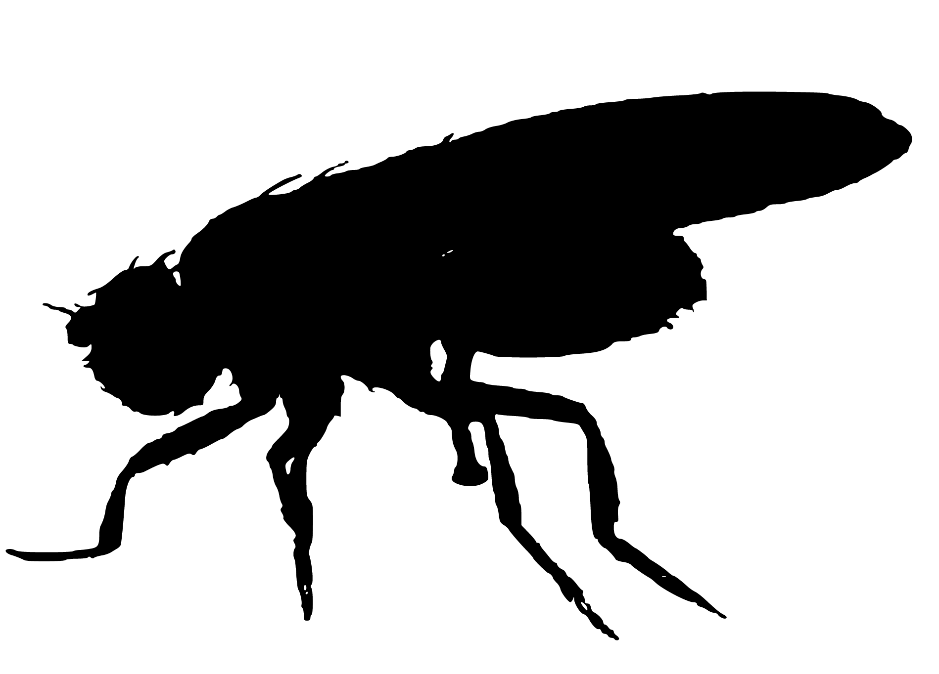
Immune cell diversity balances fast and localized responses
Adaptive
Fast
Innate
Accurate
Flexible
(Intracellular)

Slide 34
A tradeoff in each layer: defense vs repair
Adaptive
TH ↔ TReg
Innate
M1 ↔ M2
Intracellular
Apoptosis (p53) ↔ Division
ROS ↔ Antioxidants
Autophagy ↔ Synthesis
Fast
Accurate
Flexible

Slide 35
Macrophages persist at wound sites to promote repair (?)
Bentzinger et al, 2013

Slide 36
Causes of Death in Adults Over 65
Cancer
Neurodegen.
Pulmonary
Vascular
Inflammation
Oxidative Stress
Regeneration

Slide 37
Causes of Death in Adults Over 65
Cancer
Neurodegen.
Pulmonary
Vascular
Shared causes: need for theory?
Inflammation
Oxidative Stress
Regeneration

Slide 38
Causes of Death in Adults Over 65
Inverse Correlation?
Cancer
Neurodegen.
Pulmonary
Vascular
Inflammation
Oxidative Stress
Regeneration

Slide 39
50-69
70+
Zoom in: U.S.
Cancer
Cancer
Neuro
Neuro
Shared causes: need for theory?
Inflammation
Oxidative Stress
Regeneration

Slide 40
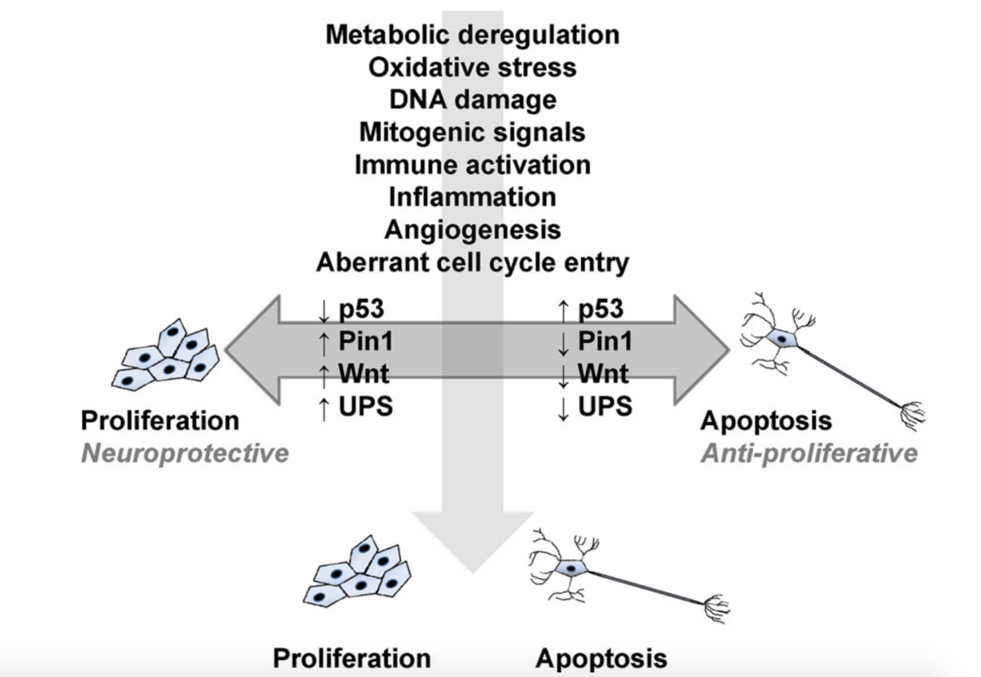
Many genes
Little clarity
Molecular Level
Cancer
Neuro
Driver, 2014

Slide 41
Many genes
Little clarity
Molecular Level
Cancer
Neuro
Driver, 2014

Slide 42
Adaptive
System Level
Laws, layers, levels
TH ↔ TReg
Innate
M1 ↔ M2
Intracellular
Apoptosis (p53) ↔ Division
ROS ↔ Antioxidants
Autophagy ↔ Synthesis
Fast
Accurate
Flexible
Molecular Level
Apoptosis
ROS Secretion
Safe
(Auto)phagy
Effective

Slide 43
Laws, layers, levels
Auto-
immune?
Adaptive
TH ↔ TReg
Innate
M1 ↔ M2
Intracellular
Apoptosis (p53) ↔ Division
ROS ↔ Antioxidants
Autophagy ↔ Synthesis
Fast
Accurate
Flexible
Molecular Level
Apoptosis
ROS Secretion
Safe
(Auto)phagy
Effective

Slide 44
Some answers?
From further afield

Slide 45
Fast
trail
Inaccurate
Reflex Layer
Rigid
Localized
Unconscious
Unstable real dynamics
Automatic
Slow
Accurate
Flexible
Stable virtual dynamics
Planning Layer
Centralized
Vision
Conscious
bumps
Deliberate

Slide 46
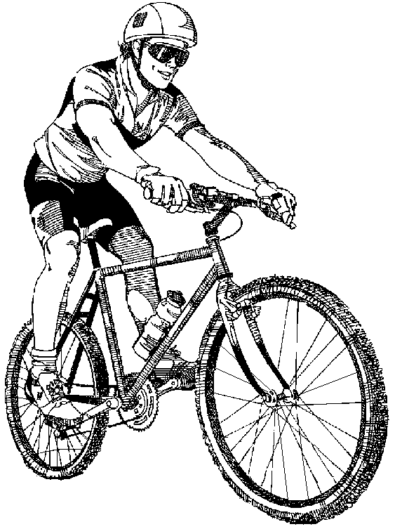
Trail&bumps
Layers
Layers
trail
Slow
Planning
Architecture
Law
bumps
DSS
Fast
Reflex
Diversity
sweet spots
Accurate
Inaccurate

Slide 47
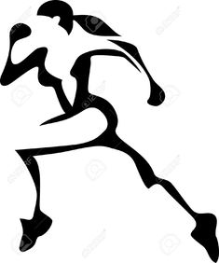
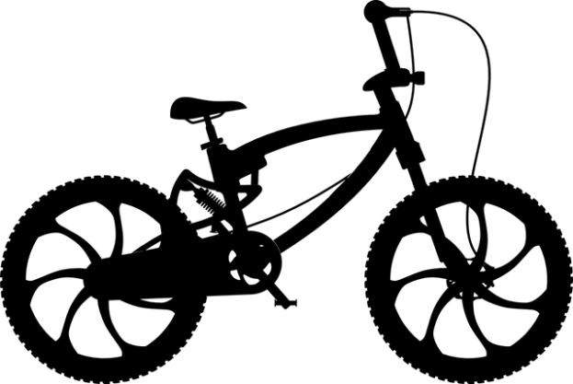
Trail&bumps
The bike&rider
system has
rider
and
bike
layers
Layers
Slow
DSS
Fast
Accurate
Inaccurate

Slide 48
Trail&bumps
The bike&rider
system has
rider
and
bike
layers
Layers
Slow
We’ll ignore the bike from now on.
Fast
Accurate
Inaccurate

Slide 49
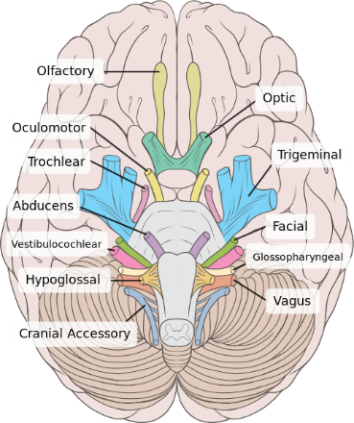
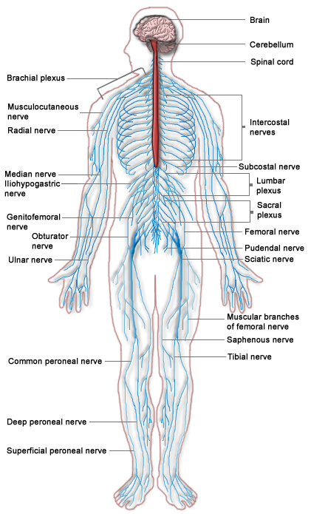
Trail&bumps
Rider level
eye
Error
Cortex
Object motion
+
vision
Head motion
Rider = system
Physiology = parts
Act
delay
Inner
ear
vest
nuclei
Tune
Physiology level
Vestibulo-
sweat
Cerebellum
reticular formation
pharynx
larynx
regurg.
muscles
balance
GI tract
nausea
diaphragm
vomiting
Bikes also have parts levels.

Slide 50
The physiology level is layered.
eye
Error
Cortex
Object motion
+
vision
Physiology level
Head motion
Act
delay
Slow
Planning
Inner
ear
vest
nuclei
Tune
Vestibulo-
Architecture
sweat
Cerebellum
reticular formation
pharynx
larynx
regurg.
muscles
balance
GI tract
nausea
Law
diaphragm
vomiting
Virtual
Fast
Reflex
Accurate
Inaccurate

Slide 51
Trail&bumps
Layers
So this is both levels and layers
Slow
Planning
Architecture
Layers
Law
DSS
Fast
Reflex
Diversity
sweet spots
Accurate
Inaccurate

Slide 52
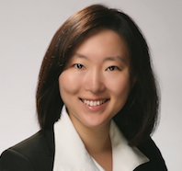
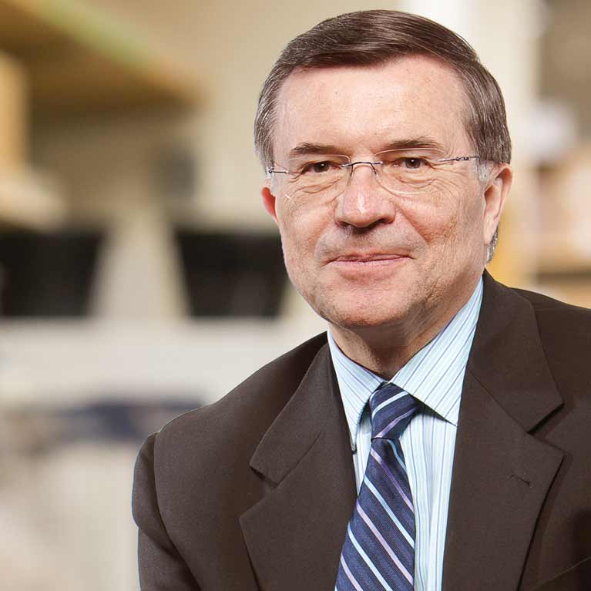
Adaptive
pMHC-TCR
Diversity Sweet Spots
FcR
Immune
Tradeoffs
Innate
DSS
Fast
Accurate
DSS everywhere
Slow
Slow oxy
Slow
reach
Muscles
walk
Transport
Fast oxy
drive
Fast
Strong
DSS
DSS
Fast glyco
Fast
fly
Accurate
Cheap
Inaccurate
Accurate
Inaccurate

Slide 53
Trail&bumps
eye
Error
Cortex
Object motion
+
vision
Slow
Planning
Head motion
Physiology
Architecture
Act
delay
Inner
ear
vest
nuclei
Tune
Vestibulo-
sweat
Cerebellum
Fast
Law
Reflex
reticular formation
pharynx
larynx
regurg.
muscles
balance
GI tract
nausea
diaphragm
vomiting
Accurate
Inaccurate
Two “orthogonal” pictures of layering. Can we do better?

Slide 54
Planning
Performance
eye
Error
Cortex
Slow
Object motion
+
vision
Architecture
Physiology
Head motion
Act
delay
Layers
Inner
ear
vest
nuclei
Tune
Law
Fast
Vestibulo-
Virtual
sweat
Cerebellum
Reflex
reticular formation
pharynx
larynx
regurg.
Accurate
muscles
balance
GI tract
nausea
Inaccurate
diaphragm
vomiting
More levels ?
It’s levels all the way down.

Slide 55
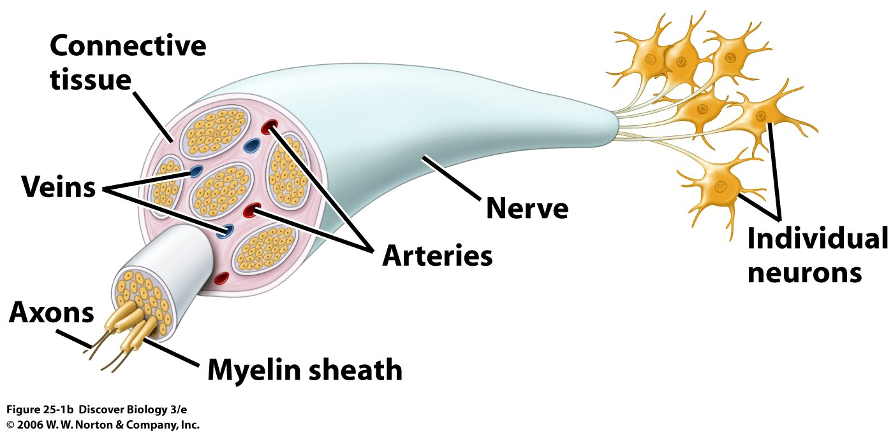
Planning
Performance
eye
Error
Cortex
Slow
Object motion
+
vision
Architecture
Physiology
Head motion
Act
delay
Layers
Inner
ear
vest
nuclei
Tune
Law
Fast
Vestibulo-
Virtual
sweat
Cerebellum
Reflex
reticular formation
pharynx
larynx
regurg.
Accurate
muscles
balance
GI tract
nausea
Inaccurate
diaphragm
vomiting
Nerves
Slow
Optic
Levels
Vestibular
Fast
Sciatic
Accurate
Inaccurate

Slide 56
H
r
Layers
V
r
trail
Slow
Theory
L
+
T
Fast
Diverse
bumps
M
Accurate
Inaccurate
S
Flexible
Rigid
G
trail
Nerves
Slow
Optic
w
Levels
Architecture
Law
bumps
Fast
Vestibular
Accurate
Inaccurate
Notes:
Here, both the block diagram in the formula split up quite nicely.
You can think this system as the sum of two subsystems. The total cost is the sum of each cost.

Slide 57
H
r
Layers
V
r
trail
Slow
Theory
L
+
T
Fast
Diverse
bumps
M
Accurate
Inaccurate
S
Flexible
Rigid
Levels
G
trail
Nerves
Slow
Optic
w
Architecture
Law
bumps
Fast
Vestibular
Accurate
Inaccurate
Notes:
Here, both the block diagram in the formula split up quite nicely.
You can think this system as the sum of two subsystems. The total cost is the sum of each cost.

Slide 58
Performance
Slow
Planning
Architecture
Law
Fast
Reflex
Accurate
Inaccurate
Flexible
Rigid
Slow
Slow oxy
Sensory Nerves
Muscles
Slow
Optic
Fast oxy
Law
Fast
Strong
Law
Fast glyco
Fast
Vestibular
Accurate
Cheap
Inaccurate
Accurate
Inaccurate

Slide 59
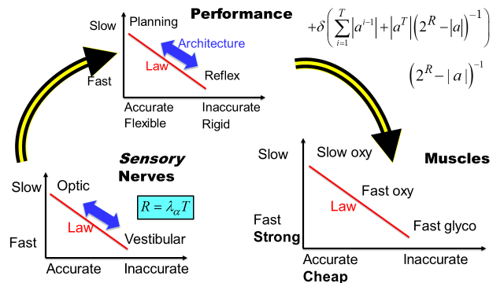
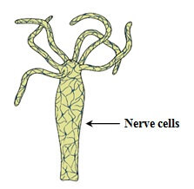
Focusing initially on sensorimotor control
Notes:
.

Slide 60
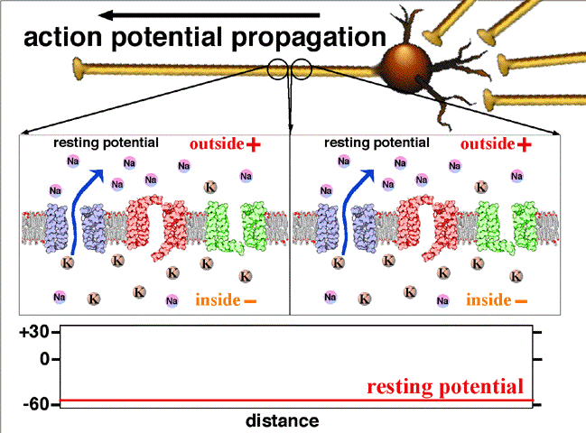
Stopped at nerve level
Lower levels (e.g. channels) heavily studied
Defer lower levels for now
Focus on additional layers (OS) and functions (speech, cognition)
More levels

Slide 61
Acquire
Translate/
integrate
Automate
Slow
Flexible
Prefrontal
Learning
Motor
Sensory
Striatum
Fast
Inflexible
Learning is high priority
How to best add learning?
Reflex
Notes:
.

Slide 62
Planning
Universal laws and
virtual
architectures
Slow
Law
Virtual
Fast
Reflex
Architectures:
Good, Bad, Ugly, Hijacked,…
Accurate
Inaccurate
Flexible
Rigid
Laws: constrains the possible
Architectures: deconstrains the lawful
Virtualization: create sweet spot

Slide 63
Software
Universal laws and architectures
“constraints that deconstrain”
Slow
Architecture
Law
Fast
Hardware
Accurate
Inaccurate
Flexible
Rigid
Gerhart &
Kirschner
Laws: constrains the possible
Architectures: deconstrains the lawful

Slide 64
Software
Universal laws and
virtual
architectures
Slow
Architecture
Law
Fast
Virtual
Hardware
Accurate
Inaccurate
Flexible
Rigid
Laws: constrains the possible
Architectures: deconstrains the lawful
Virtualization: create sweet spot

Slide 65
Software
Diversity
Sweet
Spots
Slow
Architecture
Law
Fast
DSS
Hardware
Accurate
Inaccurate
Flexible
Rigid
Laws: constrains the possible
Architectures: deconstrains the lawful
Virtualization: create sweet spot

Slide 66
Software
Slow
At any level,
a law can be
Phenomenology
“Theory”
Mathematics
Law
Fast
Hardware
Accurate
Inaccurate
Flexible
Rigid
Laws: constrains the possible

Slide 67
Slow
walk/run
Global
Transport?
Fast
Accurate
Flexible
Inaccurate

Slide 68
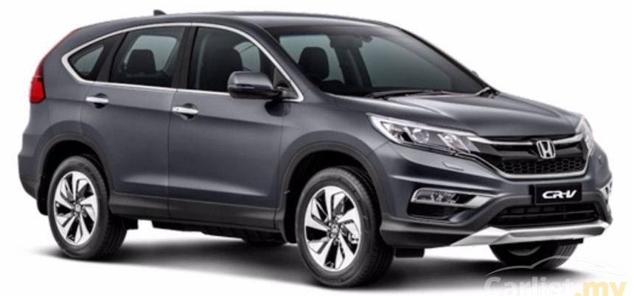
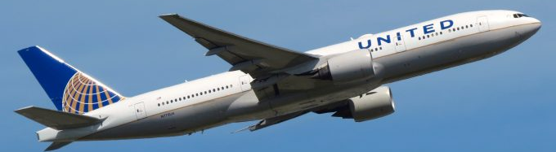
SAT=Speed
Accuracy
Tradeoffs
Slow
walk/run
Global
Transport?
drive
Fast
Not to scale
fly
Accurate
Flexible
Inaccurate

Slide 69
Fictional superheroes have different “laws”
Slow
walk/run
drive
Fast
fly
Accurate
Inaccurate

Slide 70
Global
Transport?
Manual
specific
Manual
DSS
Fast
Accurate

Slide 71
platforms
Universal
Virtual
Automatic
Unconscious
platforms
Virtual
Automatic
Unconscious
platforms
Virtual
Automatic
Unconscious

Slide 72
Digital
Virtual
Automatic
Unconscious
platforms
Universal
Active
Passive
fast
efficient
DSS
Virtual
Automatic
Unconscious
Lossless
platforms
flexible
robust
Virtual
Automatic
Unconscious
platforms
Virtual
Automatic
Unconscious

Slide 73
Virtual
Automatic
Unconscious
Layers of layers
architecture
Digital
Active
Passive
DSS
fast
efficient
Lossless
Slow
flexible
robust
Manual
DSS
Fast
Accurate
Flexible
Inaccurate

Slide 74
Digital
Active
Passive
fast
efficient
DSS
Lossless
flexible
robust
Slow
Virtual
Automatic
Unconscious
Cortex
??
DSS
Reflex
Fast
Accurate
Flexible
Inaccurate

Slide 75
Adaptive
Diversity Sweet Spots
pMHC-TCR
FcR
Immune
Tradeoffs
Innate
DSS
Fast
Accurate
DSS everywhere
Slow
Slow oxy
Slow
reach
Muscles
walk
Transport
Fast oxy
drive
Fast
Strong
DSS
DSS
Fast glyco
Fast
fly
Accurate
Cheap
Inaccurate
Accurate
Inaccurate

Slide 76
Diversity Sweet Spots
Quanying Liu
Caltech
Yorie Nakahira
DSS everywhere
Terry Sejnowski
Salk, UCSD

Slide 77
Compute/control technology
Brains/Bipedalism
Bacterial Cell
Theory of
Evolution
Architecture
Complexity
Networks
Extremes
Diversity Sweet Spot
Universal laws
and architectures?
Apps
Cortex
OS
Gene
??
HW
Trans*
DSS
Reflex
SAT=
Speed
Accuracy
Tradeoffs
Protein
Fast
Flexible
Accurate

Slide 78
Compute/control technology
Brains/Bipedalism
Bacterial Cell
Apps
OS
Compute
HW
Fast
Flexible
Accurate
Cortex
??
Brain
Reflex
Fast
SAT=
Speed
Accuracy
Tradeoffs
Flexible
Accurate
Gene
Trans*
Cell
Protein
Fast
Flexible

Slide 79
Compute/control technology
Brains/Bipedalism
Bacterial Cell
Apps
OS
DSS
Compute
HW
Diversity Sweet Spot
Fast
Flexible
Accurate
Cortex
??
DSS
Brain
Reflex
Fast
SAT=
Speed
Accuracy
Tradeoffs
Flexible
Accurate
Gene
Trans*
DSS
Cell
Protein
Fast
Flexible

Slide 80
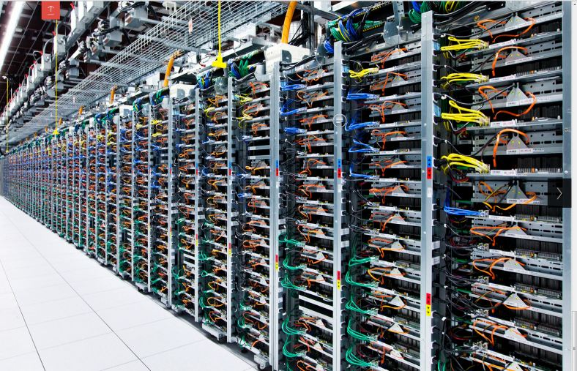
Universal laws
and architectures?
SAT=Speed
Accuracy
Tradeoffs
Apps
Cortex
OS
Gene
??
HW
Trans*
Reflex
Diverse Hardware
Fast
Protein
Flexible

Slide 81
Universal laws
and architectures?
Diverse Apps
SAT=Speed
Accuracy
Tradeoffs
Apps
Cortex
OS
Gene
??
HW
Trans*
Reflex
Fast
Protein
Flexible
Accurate

Slide 82
Universal laws
and architectures?
Diverse Apps
Uniform OSes
Apps
Cortex
OS
Gene
??
HW
Trans*
Reflex
Diverse Hardware
Fast
Protein
Flexible
Accurate

Slide 83
Universal laws
and architectures?
Diverse Apps
Diversity Sweet Spot
Uniform OSes
Apps
Cortex
OS
Gene
??
HW
Trans*
DSS
Reflex
Diverse Hardware
Fast
Protein
Flexible
Accurate

Slide 84
Compute/control technology
Brains/Bipedalism
Bacterial Cell
Universal laws
and architectures?
Diversity Sweet Spot
Diverse Apps
Uniform OSes
Cortex
??
DSS
Reflex
Diverse Hardware
Fast
Flexible
Accurate

Slide 85
Software
Universal laws and
virtual
architectures
Slow
Architecture
Law
Fast
Virtual
Hardware
Accurate
Inaccurate
Flexible
Rigid
Laws: constrains the possible
Architectures: deconstrains the lawful
Virtualization: create sweet spot

Slide 86
Software
Diversity
Sweet
Spots
Slow
Architecture
Law
Fast
DSS
Hardware
Accurate
Inaccurate
Flexible
Rigid
Laws: constrains the possible
Architectures: deconstrains the lawful
Virtualization: create sweet spot

Slide 87
Simpler
example?
Trail&bumps
Layers
Slow
Planning
Architecture
Layered architectures
Layers
Law
Fast
Virtual
Reflex
Diversity
sweet spots
Accurate
Inaccurate

Slide 88
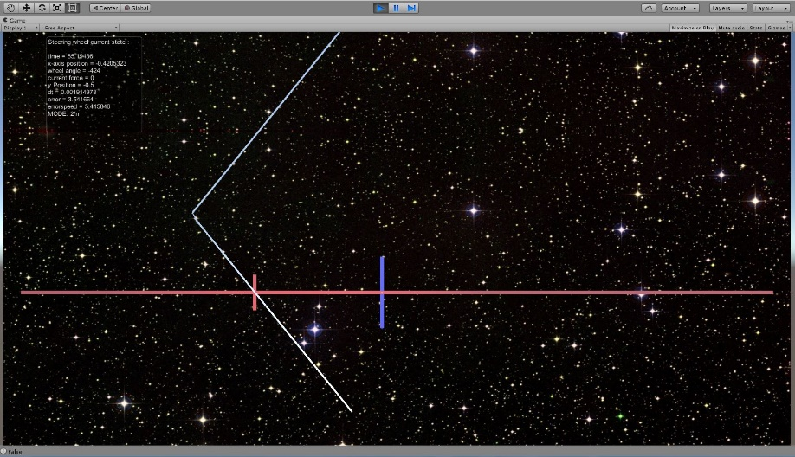
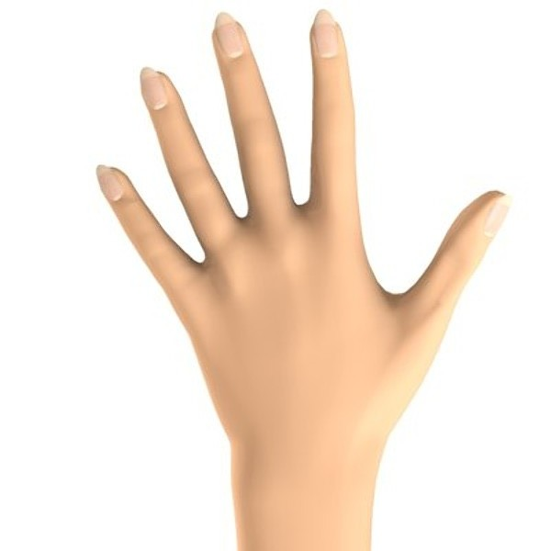
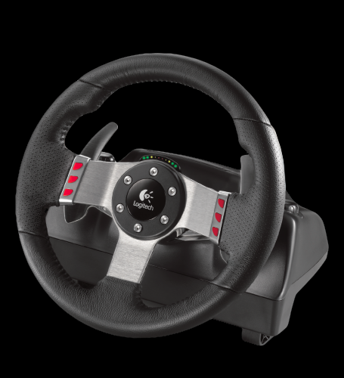
Object motion
Trail
Slow
Bumps
Experiments
Head motion
100
hardest!
hard
10
Fast
2
.1
.2
.5
1
Length, m
Waterbed

Slide 89
Trail
Bumps
Experiments

Slide 90
Object motion
Simpler
example?
Slow
Experiments
Head motion
100
hardest!
hard
10
Fast
2
.1
.2
.5
1
Length, m
Waterbed

Slide 91
Note: This doesn’t work in video format, so this experiment to be done using .pptx format.
Easy to read slow text
.5 Hz
1 Hz
Easy to read slow text
Hard to read fast text
2 Hz
3 Hz
Hard to read fast text

Slide 92
Easy to read slow text
.5 Hz
1 Hz
Easy to read slow text
Hard to read fast text
2 Hz
3 Hz
Shake your head “no” as fast as you can
Hard to read fast text

Slide 93
Easy to read slow text
.5 Hz
1 Hz
Easy to read slow text
Hard to read fast text
2 Hz
3 Hz
Shake your head “no” as fast as you can
Hard to read fast text

Slide 94
Object motion
Slow
Head motion
Why?
Fast
System/environ behavior
Extreme diversity

Slide 95
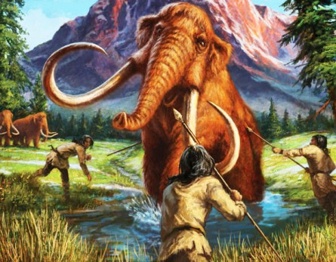
Object motion
Why? How?
Slow
Slow
object
Tradeoff
Head motion
Fast
Ideal
head
Flexible
Accurate
Fast
Inflexible
Innac.

Slide 96
Error
Cortex
Object motion
eye
+
vision
slow
Act
delay
Slow
vision
High
Bandwidth
Fast
Flexible
Accurate
Inflexible

Slide 97
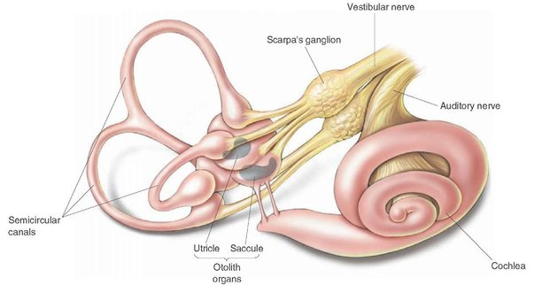
Error
Cortex
Object motion
eye
+
vision
Head motion
Does not use “vision”?
Low delay
Act
delay
VOR
fast
slow
Slow
vision
Fast
VOR
Vestibular Ocular Reflex (VOR)
Flexible
Inflexible
Inaccurrate

Slide 98
Error
Cortex
Mechanism
Object motion
eye
+
vision
Minimal cartoon
Head motion
Act
Layered architecture
delay
VOR
fast
slow
Slow
vision
Tradeoff
Diversity
sweet spots
Fast
DSS
VOR
Flexible
Accurate
Inflexible
Innac.

Slide 99
trail
Layers
Object motion
Slow
Planning
Vision
Slow
Fast
Reflex
Ideal
Accurate
Inaccurate
Flexible
Rigid
Centralized
Localized, distributed
Conscious
Unconscious
Deliberate
Automatic
Stable virtual
Unstable real dynamics

Slide 100
Slow
Planning
bumps
Head motion
Fast
Reflex
Ideal
Fast
Accurate
Inaccurate
Flexible
Rigid
Centralized
Localized, distributed
Conscious
Unconscious
Deliberate
Automatic
Stable virtual
Unstable real dynamics

Slide 101
Error
Cortex
Object
eye
vision
+
Head
fast
Act
delay
Inner
ear
vest
nuclei
Tune
log(delay)
Vestibulo-
Cerebellum
1 sec
Tradeoff
vision
VOR
DSS
10⁻²
Fast
Balance?
Flexible
accurate

Slide 102
Error
Cortex
Object
eye
vision
+
Head
fast
Act
delay
Inner
ear
vest
nuclei
Tune
log(delay)
Vestibulo-
Cerebellum
reticular formation
1 sec
Tradeoff
vision
VOR
muscles
balance
DSS
10⁻²
proprio
Fast
balance
Flexible
accurate

Slide 103
Error
Cortex
Object
eye
vision
+
Head
fast
Act
delay
Inner
ear
vest
nuclei
Tune
log(delay)
Vestibulo-
Cerebellum
reticular formation
1 sec
vision
VOR
muscles
balance
10⁻²
proprio
Fast
balance
Flexible
accurate

Slide 104
Error
Cortex
Object
eye
vision
+
Head
fast
Act
delay
Inner
ear
vest
nuclei
Tune
log(delay)
Vestibulo-
Cerebellum
reticular formation
1 sec
vision
VOR
muscles
balance
10⁻²
proprio
Fast
balance
Flexible
accurate

Slide 105
Error
Cortex
Object
eye
vision
+
Head
fast
Act
delay
Inner
ear
vest
nuclei
Tune
log(delay)
Vestibulo-
Cerebellum
reticular formation
1 sec
vision
VOR
muscles
balance
10⁻²
proprio
Fast
balance
Flexible
accurate

Slide 106
Error
Cortex
Object
eye
vision
+
Head
fast
Act
delay
Inner
ear
vest
nuclei
Tune
log(delay)
Vestibulo-
Cerebellum
reticular formation
1 sec
vision
VOR
muscles
balance
10⁻²
proprio
Fast
balance
Flexible
accurate

Slide 107
Error
Cortex
Object motion
eye
+
vision
motionn sickness?
Head motion
Act
delay
fast
Inner
ear
vest
nuclei
Tune
Vestibulo-
Cerebellum
muscles
balance

Slide 108
Error
Cortex
Object motion
eye
+
vision
motion sickness
Head motion
Act
delay
fast
Inner
ear
vest
nuclei
Tune
Vestibulo-
sweat
Cerebellum
reticular formation
pharynx
larynx
regurg.
muscles
balance
GI tract
nausea
diaphragm
vomiting

Slide 109
Error
Cortex
Object motion
eye
+
vision
motion sickness
Why nausea?
Head motion
Act
delay
fast
Inner
ear
vest
nuclei
vest
nuclei
sensitive sensor
Tune
Vestibulo-
sweat
Cerebellum
reticular formation
pharynx
larynx
regurg.
GI tract
nausea
diaphragm
vomiting

Slide 110
Adaptive
pMHC-TCR
Diversity Sweet Spots
FcR
Immune
Tradeoffs
Innate
DSS
Fast
Accurate
DSS everywhere
Slow
Slow oxy
Slow
reach
Muscles
walk
Transport
Fast oxy
drive
Fast
Strong
DSS
DSS
Fast glyco
Fast
fly
Accurate
Cheap
Inaccurate
Accurate
Inaccurate

Slide 111
Adaptive
pMHC-TCR
FcR
Immune
Tradeoffs
Innate
DSS?
Fast
Accurate
Slow
Slow oxy
Slow
reach
Muscles
walk
Transport
Fast oxy
drive
Fast
Strong
DSS
DSS
Fast glyco
Fast
fly
Accurate
Cheap
Inaccurate
Accurate
Inaccurate

Slide 112
Horizontal App Transfer
App
App
App
App
App
App
App
App
Horizontal transfer
App
App
App
App
App
App
HGT
App
App
Slow
Apps
Trans*
OS
Protein
DSS
HW
HW
Fast
HW
Horizontal Hardware Transfer
HW
HW
Flexible
Inflexible
HW

Slide 113
Horizontal App Transfer
App
App
App
Gene
Gene
App
App
Gene
Horizontal transfer
App
App
Gene
App
Gene
App
Gene
HGT
App
Gene
Slow
Apps
Trans*
OS
Protein
HW
HW
Fast
HW
Horizontal Hardware Transfer
HW
HW
Flexible
Inflexible
HW

Slide 114
Horizontal App Transfer
App
App
App
Gene
Gene
App
App
Gene
Hijacking
App
App
Gene
App
Gene
App
Gene
HGT
App
Gene
Slow
Virus
Apps
Trans*
OS
Protein
HW
HW
Fast
HW
Horizontal Hardware Transfer
HW
HW
Flexible
Inflexible
HW

Slide 115
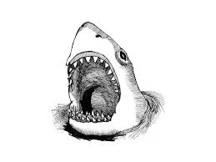
Predators don’t care about architecture
Gene
OK to ignore/destroy architecture
Trans*
OS
Protein
HW
Reflex

Slide 116
Predators don’t care about architecture
OK to ignore/destroy architecture
Protein
HW
Reflex
Consumes physical building blocks

Slide 117
Parasites hijack architectures
Virus
Virtualized
and
internal
(hidden)
Gene
Apps
Slow
Trans*
Cortex
OS
Protein
HW
Illusion
Fast
Reflex
Flexible
Inflexible

Slide 118
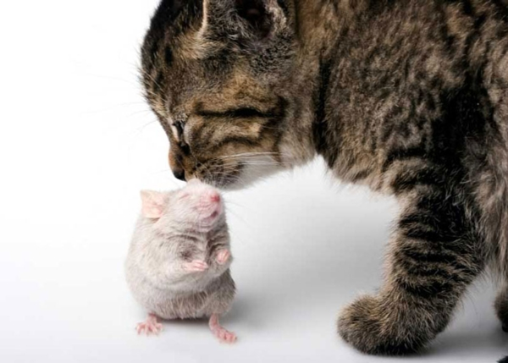
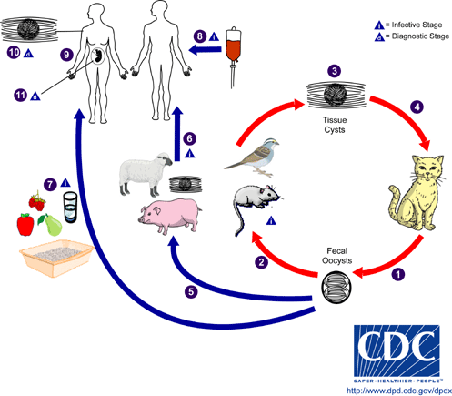
Toxoplasmosis
Zombie parasites

Slide 119
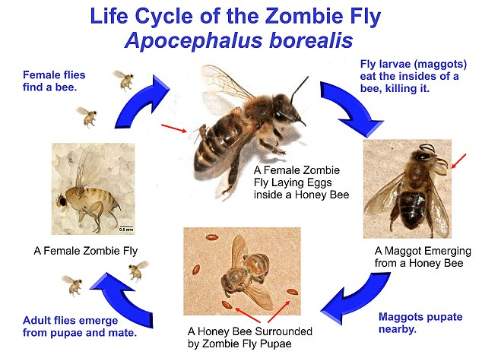
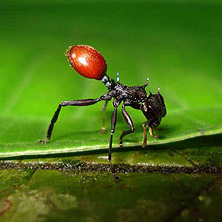
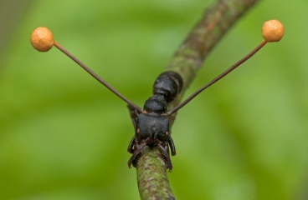
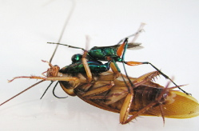
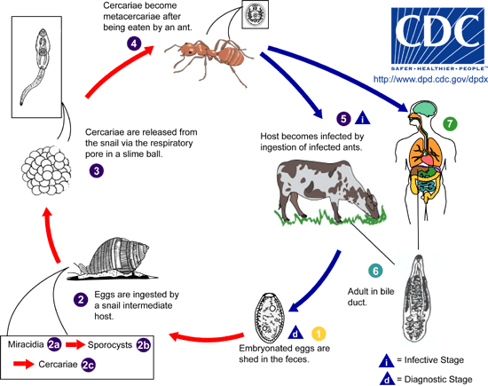
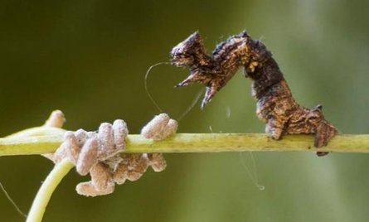
Zombie parasites

Slide 120
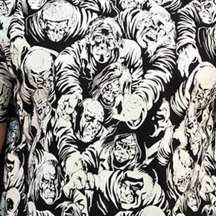
Zombie
Zombieness
Predator?
Parasite?
Zience fiction

Slide 121
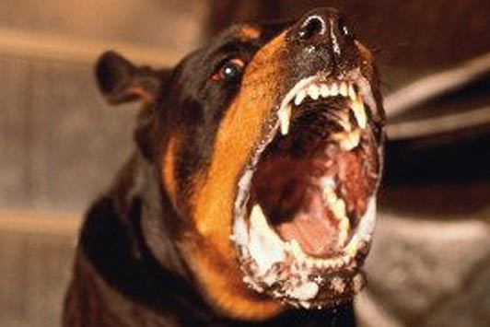
Zombie
Zombieness
Rabies
Predator?
Parasite?

Slide 122
Zombie parasites hijack complex behaviors
Zombie
Virtualized
and
internal
(hidden)
Gene
Apps
Slow
Trans*
Cortex
OS
Protein
HW
Illusion
Fast
Reflex
Flexible
Inflexible

Slide 123
Zombie
memes?
Bad Meme Transfer
Hijacking?
Beliefs
Viral
False
Unhealthy
Dangerous
meme
Meaning
Syntax
Words
Phonemes
Cortex
Fast
Reflex
Flexible

Slide 124
Laws, layers, levels
Auto-
immune?
Adaptive
TH ↔ TReg
Innate
M1 ↔ M2
Intracellular
Apoptosis (p53) ↔ Division
ROS ↔ Antioxidants
Autophagy ↔ Synthesis
DSS?
Fast
Accurate
Flexible
Molecular Level
Apoptosis
ROS Secretion
Safe
(Auto)phagy
Effective

Slide 125
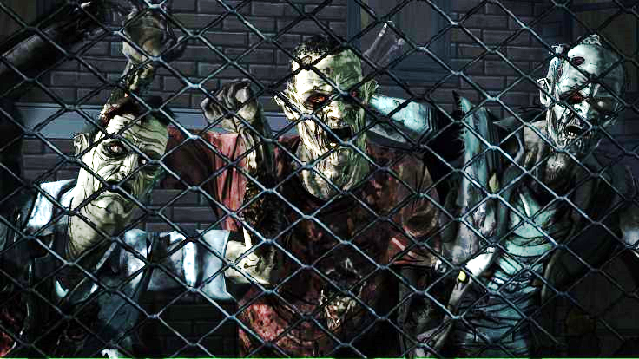
Zombie Science
(Zience)

Slide 126
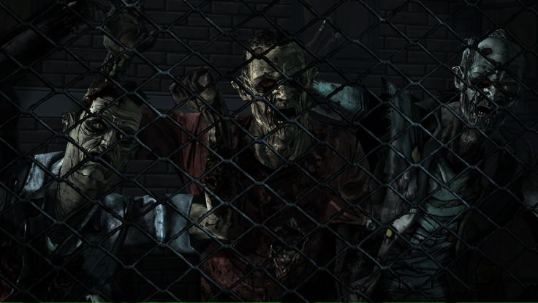
Zombies
Zombie Science
(Zience)
Science fiction
Wildly popular
Contagious, viral
Useless, dangerous
No mind
Threatens all humans
Refractory to treatment
Emergent
Fictional science
Wildly popular
Contagious, viral
Useless, dangerous
No rigor
Threatens all sciences
Refractory to debunking
Emergence
Unretracted (unretractable)
Ztatistics (wrong statistics)
Zcholarship (ignores prior work)
Videos

Slide 127
Human physiology
Extras

Slide 128
Robust
Human physiology
Fragile
Metabolism
Regeneration & repair
Healing wound /infect
Efficient cardiovascular
Obesity, diabetes
Cancer
AutoImmune/Inflame
C-V diseases
Infectious diseases
Lots of triage

Slide 129
Robust
Benefits
Metabolism
Regeneration & repair
Healing wound /infect
Efficient cardiovascular
Efficient, adaptive to diverse challenges
Run/rest/sleep
Eat/drink/starve
Trauma/Infection
Hot/cold
Etc etc

Slide 130
Tradeoffs
fragile
4x
robust
efficient
costly

Slide 131
Robust
Mechanism?
Fragile
Metabolism
Regeneration & repair
Healing wound /infect
Obesity, diabetes
Cancer
AutoImmune/Inflame
Fat accumulation
Insulin resistance
Proliferation
Inflammation

Slide 132
Robust
Mechanism?
Fragile
Metabolism
Regeneration & repair
Healing wound /infect
Fat accumulation
Insulin resistance
Proliferation
Inflammation
Obesity, diabetes
Cancer
AutoImmune/Inflame
Fat accumulation
Insulin resistance
Proliferation
Inflammation

Slide 133
Robust
What’s the difference?
Fragile
Metabolism
Regeneration & repair
Healing wound /infect
Obesity, diabetes
Cancer
AutoImmune/Inflame
Fat accumulation
Insulin resistance
Proliferation
Inflammation
Controlled
Acute/responsive
Uncontrolled
Chronic

Slide 134
Robust
Challenges
Metabolism
Regeneration & repair
Healing wound /infect
Efficient cardiovascular
Efficient, adaptive to diverse challenges
Run/rest
Eat/drink/starve
Trauma/Infection
Hot/cold
Etc etc

Slide 135
Fat accumulation
Insulin resistance
Proliferation
Inflammation
Controlled
Acute/responsive
Low mean
High variability

Slide 136
Fat accumulation
Insulin resistance
Proliferation
Inflammation
Death
Controlled
Acute/responsive
Uncontrolled
Chronic
Low mean
High variability
High mean
Low variability

Slide 137
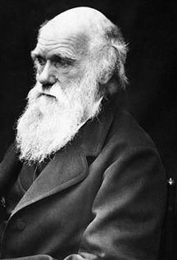
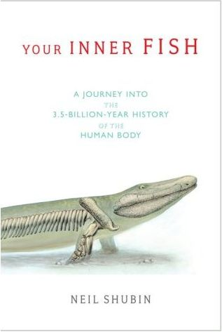
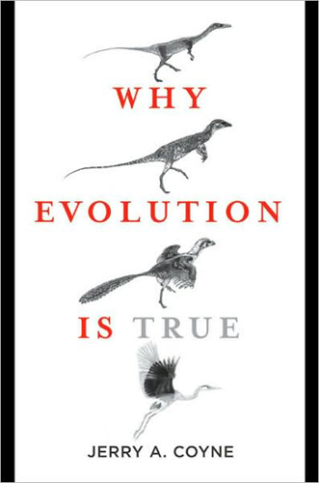
Human physiology
Not intelligent design
Ouch.

Slide 138
Robust
Restoring robustness?
Fragile
Metabolism
Regeneration & repair
Healing wound /infect
Obesity, diabetes
Cancer
AutoImmune/Inflame
Fat accumulation
Insulin resistance
Proliferation
Inflammation
Fat accumulation
Insulin resistance
Proliferation
Inflammation
Heal
Controlled
Acute
Uncontrolled
Chronic

Slide 139
Robust
Restoring robustness?
Fragile
Metabolism
Regeneration & repair
Healing wound /infect
Obesity, diabetes
Cancer
AutoImmune/Inflame
Fat accumulation
Insulin resistance
Proliferation
Inflammation
Exercise
Fat accumulation
Insulin resistance
Proliferation
Inflammation
Heal
Controlled
Acute
Uncontrolled
Chronic

Slide 140
Robust
Restoring robustness?
Fragile
Metabolism
Regeneration & repair
Healing wound /infect
Obesity, diabetes
Cancer
AutoImmune/Inflame
Fat accumulation
Insulin resistance
Proliferation
Inflammation
Fat accumulation
Insulin resistance
Proliferation
Inflammation
Controlled
Acute
Heal
Uncontrolled
Chronic
Control systems failing on.

Slide 141
140
High mean
Low variability
120
Heart rate variability (HRV)
100
80
60
Low mean
High variability
40
∞ publications
Correlations
All of medicine
Mechanism??
Healthy =
Not =
time(sec)
Low mean
High variability
High mean
Low variability

Slide 142
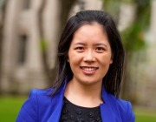
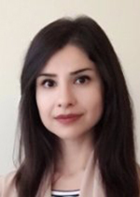
Bipedalism (balance, cardiovascular physiology)
Fragile
controls
errors
Bodies
heart rate
ventilation
vasodilation
coagulation
inflammation
digestion
storage
…
O2
BP
pH
Glucose
Energy store
Blood volume
…
Mechanistic
Physiology
Robust efficiency
Robust
cheap
costly
Videos
efficiency
external disturbances
Li, Cruz, Chien, Sojoudi, Recht, Stone, Csete, Bahmiller, Doyle
Robust efficiency and actuator saturation explain healthy heart rate control and variability
Proc. Nat. Acad. Sci. PLUS 2014

Slide 143
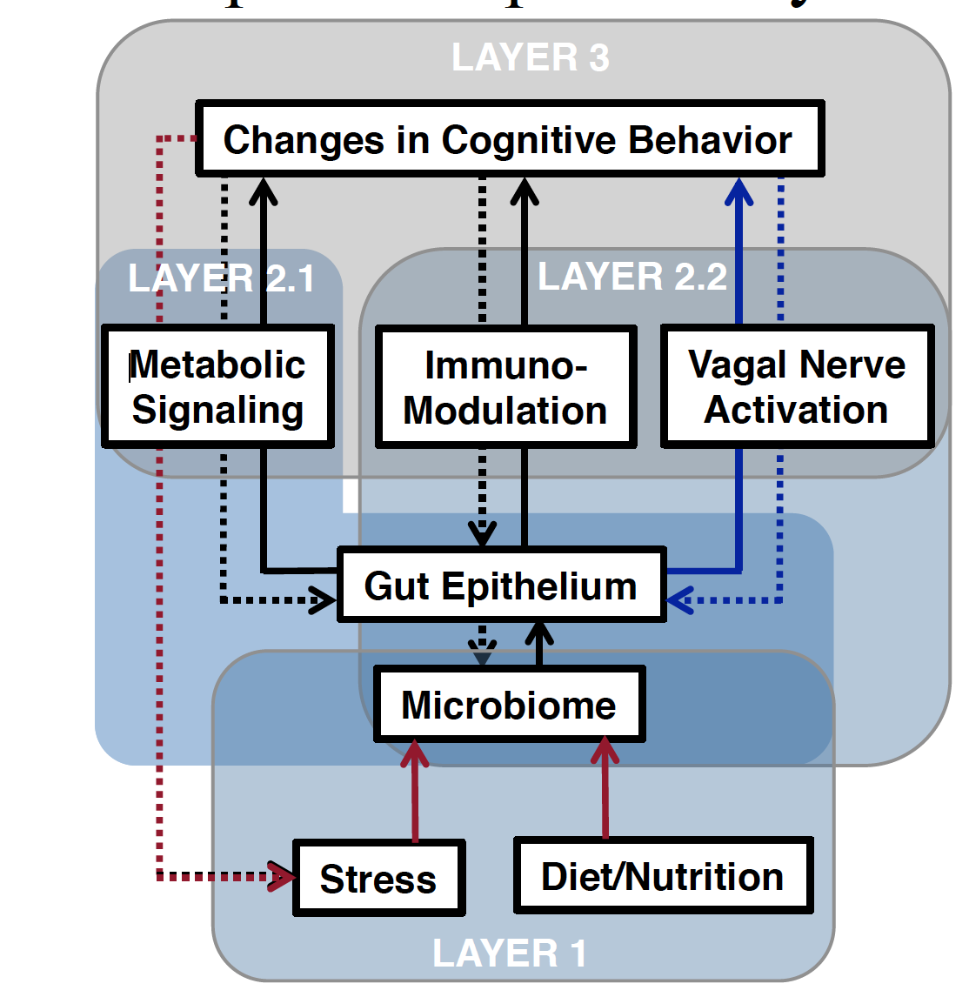
Extreme diversity
What is done?
Where?
How?
Why?
Necessary?
Layers
Elaine Hsiao, UCLA

Slide 144
Stabilizable but fragile
Stable

Slide 145
Other examples
Stabilizable but fragile
Death
Life
Stable

Slide 146
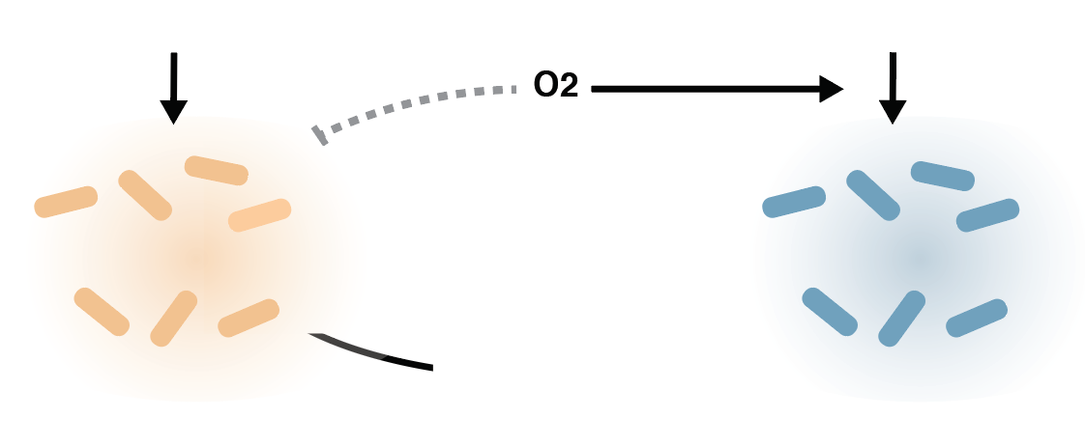
Hypothesis
Complex polysaccharides
(e.g. dextran)
Starter “fuel”
(e.g. glucose)
Stabilizable but fragile
B. thetaiotaomicron
K. pneumoniae
simple sugars
SCFA
Tahmineh Khazaei
[KP]
“State 1”
Growth of facultative anaerobe only
KP
Glucose Flux In

Slide 147
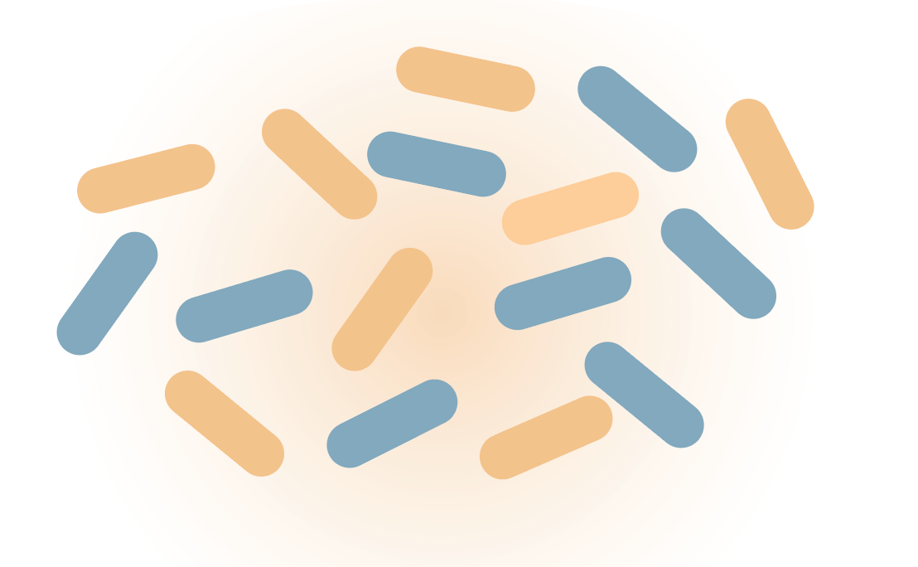
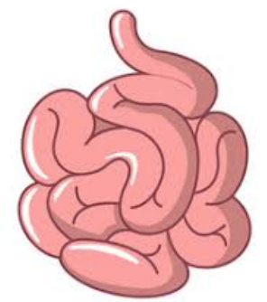
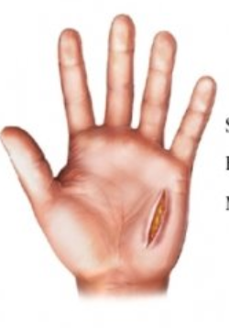
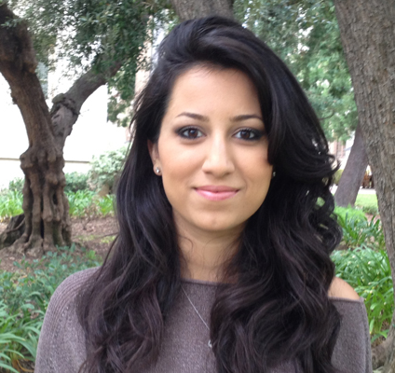
aerobe + anaerobe community
aerobe community
Stabilizable but fragile
Stable
Multistability and hysteresis
Tahmineh Khazaei
small intestinal bacterial overgrowth
periodontal
diseases
wound infections

Slide 148
aerobe + anaerobe community
aerobe community
Stabilizable but fragile
Stable
Sick
Multistability and hysteresis

Slide 149
Complex polysaccharides
(e.g. dextran)
Starter “fuel”
(e.g. glucose)
O2
B. thetaiotaomicron (Bt)
K. pneumoniae (Kp)
[KP]
“State 1” : Aerobe-only
Growth of facultative anaerobe only
Kp
Stabilizable but fragile
Glucose Flux In

Slide 150
Complex polysaccharides
(e.g. dextran)
Starter “fuel”
(e.g. glucose)
Stable
B. thetaiotaomicron (Bt)
K. pneumoniae (Kp)
simple sugars
SCFA
“State 2”:
Growth of anaerobic bacteria resulting in overgrowth of facultative anaerobe
[KP]
Kp+Bt
Kp
Glucose Flux In

Slide 151
Complex polysaccharides
(e.g. dextran)
Starter “fuel”
(e.g. glucose)
Multistability and hysteresis
in theory and experiment
O2
B. thetaiotaomicron (Bt)
K. pneumoniae (Kp)
simple sugars
SCFA
[KP]
Kp+Bt
Hysteresis
Stable
Kp
Stabilizable but fragile
Glucose Flux In

